Slide 1
Payroll system for dilshan tex

Slide 2
Structure of the programe
Employee Class
Functions from employee and managemen-t classes
Management
Class
Main function

Slide 3
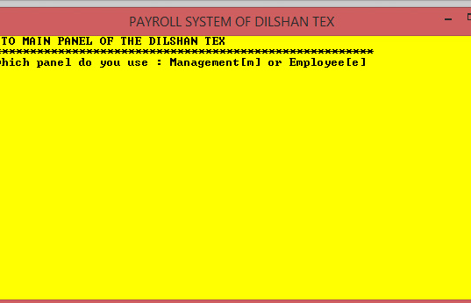
This is the Main panel of the program, you have to choose which panel you are willing to use.

